Slide 1
Thomas Aquinas
Dr. Stephanie Spoto
3/7/2019
Monterey Peninsula College
Gentrain 405: The Medieval World, Part I

Slide 2
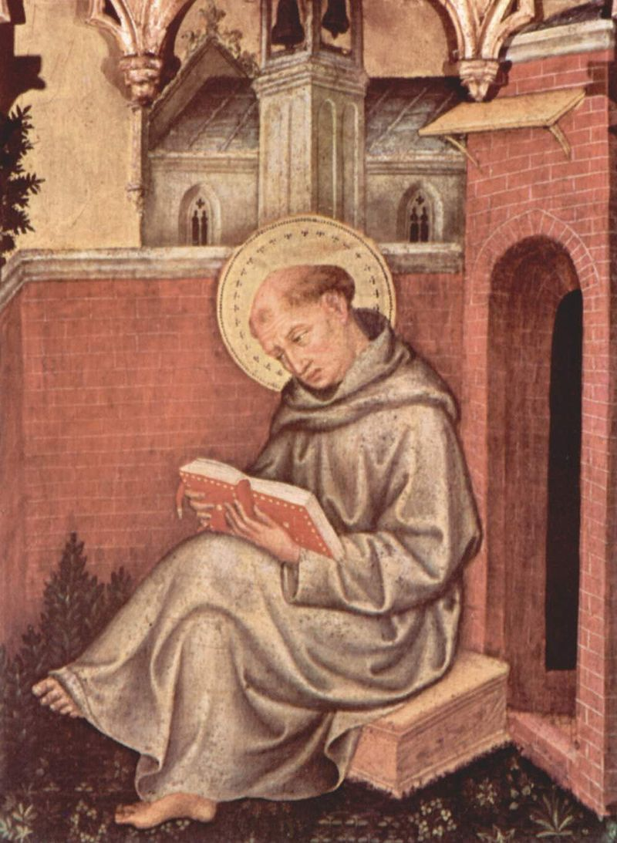
Thomas Aquinas 1225-1274 CE
Thomas of Aquino → born in county of Aquino (modern day Lazio, Sicily)
Dominican friar → very important and influential theologian, philosopher and jurist.
Catholic Church: Aquinas canonized → model teacher, expressing highest form of natural reason and theology.
20th/21st centuries: Works still used as part of the core program of the education leading to the ordination of priests and deacons.

Slide 3
Scholasticism
Dominated European universities from around 1100 to 1700
Not a philosophy but a method of critical thought and learning
Often used to defend church dogma in increasingly pluralistic religious environments → emphasized dialectical reasoning
Dialectical reasoning: two sides with different views come together to work towards truth (contrast with didactic method, where one side teaches the other, or with debate, which would use clever rhetoric or emotional appeals to “win”)
Known for conceptual analysis and the nuanced drawing of distinctions.
In classroom/education: topic from tradition addressed as a question, responses from either side, etc.
Dialectical method rigorous → was adapted to other fields of study.

Slide 4
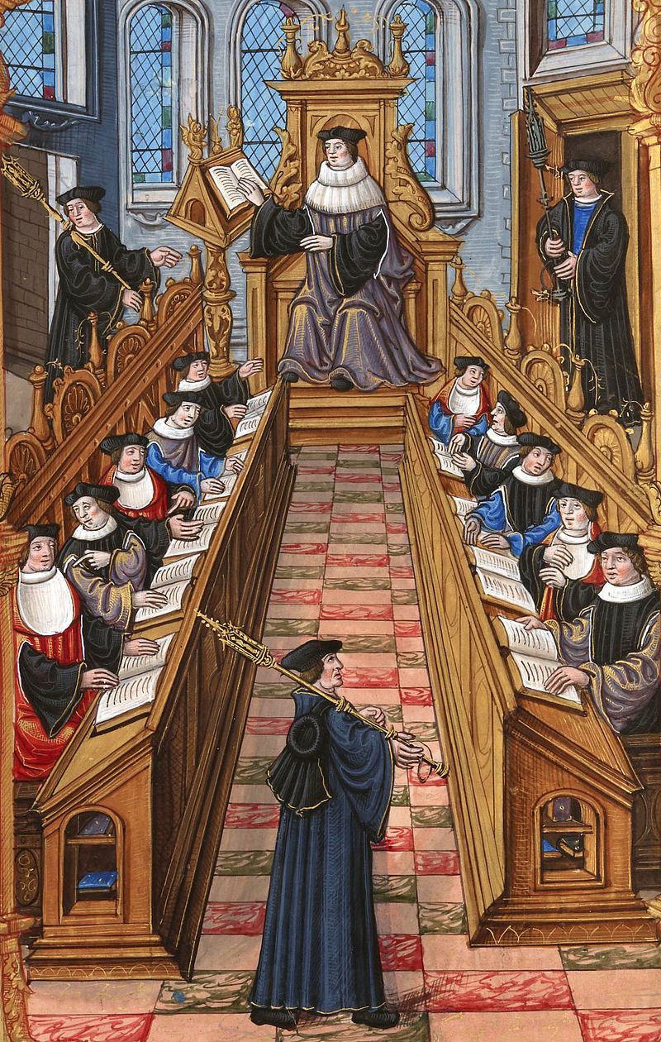
Scholasticism’s and pre-Christian philosophy
Began as attempt to bring harmony to medieval Christian thought
Worked to harmonize various thinkers to their own tradition
To reconcile Christian thought with pre-Christian philosophy (especially Aristotle) and Neoplatonism
This has a history in early Christian apologists → early Greek Christians who sought to defend Christianity from attack (like Origen)
Christian apologists: Did not try to separate themselves from Greek philosophy, but wanted to demonstrate themselves as in dynamic relationship with tradition of Greek rationalism (like the pre-Socratics).
Étienne Colaud - BNF, Français 1537, A meeting of doctors at the university of Paris.

Slide 5
Expanding on St. Anselm’s Ontological Proof
Anselm’s Ontological Proof: We can imagine a perfect, all-powerful being, and the reality of that being is more powerful than the imagination of it.
According to Irish Murdoch, in Metaphysics as a Guide to Morals, Aquinas was not satisfied by Anselm’s Ontological Proof
Though she notes that Aquinas’s fourth proof resonates with Anselm’s notion of perfection existing outside of the mind and not just in the imagination.

Slide 6
Aquinas: Proof of the Existence of God from Alex Domenech’s The Domenech Bible Interpretations, 2015
Motion: Some things undoubtedly move, though cannot cause their own motion. Since, as Aquinas believed, there can be no infinite chain of causes of motion, there must be a First Mover not moved by anything else, and this is what everyone understands by God.
Causation: As in the case of motion, nothing can cause itself, and an infinite chain of causation is impossible, so there must be a First Cause, called God.
Existence of necessary and the unnecessary: Our experience includes things certainly existing but apparently unnecessary. Not everything can be unnecessary, for then once there was nothing and there would still be nothing. Therefore, we are compelled to suppose something that exists necessarily, having this necessity only from itself; in fact itself the cause for other things to exist.
Gradation: If we can notice a gradation in things in the sense that some things are more hot, good, etc., there must be a superlative that is the truest and noblest thing, and so most fully existing. This then, we call God.
Ordered tendencies of nature: A direction of actions to an end is noticed in all bodies following natural laws. Anything without awareness tends to a goal under the guidance of one who is aware. This we call God.

Slide 7
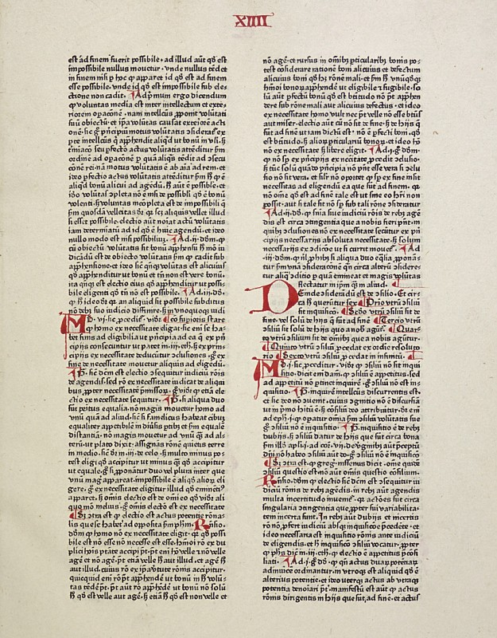
The Nature of God Negative Theology
Considering what God is not (compare with Hermeticism and Gnosticism)
Without body: God is simple → without composition of parts, such as body and soul, or matter and form.
Lacks nothing: God is perfect, lacking nothing. Unique → God’s complete actuality
Not finite: God is infinite → not finite like created beings (physically, intellectually limited.
Unchanging: God is immutable → no change to essence or character
Without diversification: God is one → unity of God. God’s essence is the same as his existence.
Aquinas: "in itself the proposition 'God exists' is necessarily true, for in it subject and predicate are the same.“ (Summa Theologiae)
Page from Summa Theologiae, 1475

Slide 8
Sin and Law in Aquinas
Similar to St. Augustine, Aquinas defines sin as "a word, deed, or desire, contrary to the eternal law.”
The same in Aquinas’s legal philosophy → Natural law is manifestation of eternal law.
Natural Law: what people understand/determine by their own rational nature, to disobey reason is to disobey natural and eternal law.
Eternal law: Ideal order of the universe, existing in the mind of God (logos)
Human law: “the more particular determinations of certain matters devised by human reason.”
Divine law: the will of God revealed in the Scripture. Necessary for four reasons:
humans need explicit divine guidance on how to perform proper acts;
uncertainty of human judgment needs a check
humans need divine insight on issues on which they are not competent to judge
it proves that God will punish some deeds that even go beyond the ability of human law to punish.

Slide 9
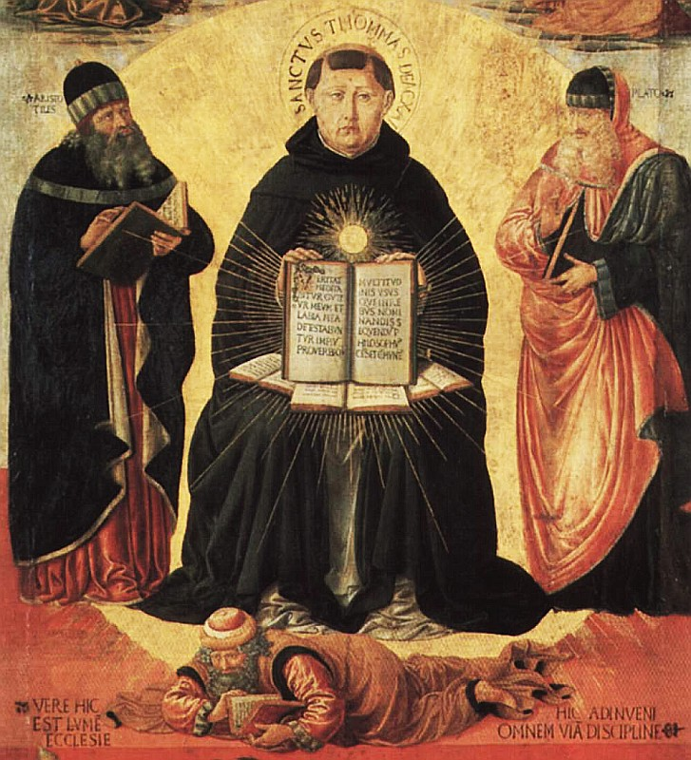
Natural Law, Eternal Law, and Human Reason
"It is evident that all things partake somewhat of the eternal law, in so far as, namely, from its being imprinted on them... Wherefore it (human nature) has a share of the Eternal Reason, whereby it has a natural inclination to its proper act and end: and this participation of the eternal law in the rational creature is called the natural law."
(Summa Theologiae, 2.1)
Detail from "Triumph of St. Thomas Aquinas over Averroes" by Benozzo Gozzoli (1420–97)

Slide 10
Aquinas on the goal of human life
Goal of human life: Eternal union and fellowship with God
Achieved through the beatific vision: an experience of perfection and unending happiness in witnessing God’s essence. Vision after death to people who experience redemption and salvation through Christ.
Implications for life on earth: Person’s will must be towards the right things: holiness, charity, and peace.
Towards happiness: This orientation leads towards happiness → treatment of the right ordered around idea of happiness.
Will and goal → relationship that has antecedent in nature: “"because rectitude of the will consists in being duly ordered to the last end [that is, the beatific vision]."
To seek God through understanding will be to love what God loves → seat of morality which will have positive outcomes in everyday choices.

Slide 11
Principle of double effect First appeared in Summa Theologiae as a discussion on homicidal self-defense
An ethical criteria set out by Christian philosophers (and others) → evaluates the permissibility of an act which might lead to causing effect one would want to avoid
For example, act: relieving a terminally ill patient in pain; effect: shortened life
Foreseen harmful effects that are inseparable from the good effect is justifiable if the following is true:
the nature of the act is itself good, or at least morally neutral;
the agent intends the good effect and does not intend the bad effect either as a means to the good or as an end in itself;
the good effect outweighs the bad effect in circumstances sufficiently grave to justify causing the bad effect and the agent exercises due diligence to minimize the harm.

Slide 12
Modern Influence
Much of Aquinas’s work has been very influential.
In moral philosophy: modern ethicists (religious and secular) have noted that Thomas’s virtue ethics might be a way of avoiding Kantian deontology and utilitarianism. (Philippa Foot and Alasdair MacIntyre)
Elizabeth Anscombe, Intention (1957): Aquinas’s principle of double effect very influential
Umberto Eco: Aquinas’s aesthetics very influential

